Slide 1

GLP-1 Receptor Agonists as a Bridge-to-Surgery
in Patients with Morbid Obesity
G. Pavone, E. Lamanna, M. Pacilli, F. VOVOLA, A. GIULIANI, F. FOGLIO, A. MELI, A. Ambrosi, N. Tartaglia
Università degli studi di Foggia
Clinica Chirurgica:
Direttore Prof. Antonio Ambrosi
Scuola di Specializzazione in Chirurgia Generale:
Direttore Prof. Nicola Tartaglia

Slide 2
Background
Bariatric surgery is the most effective long-term treatment for morbid obesity
Preoperative weight loss improves outcomes and reduces surgical risk
- Eisenberg D, Shikora SA, Aarts E, Aminian A, Angrisani L, Cohen RV, De Luca M, Faria SL, Goodpaster KPS, Haddad A, Himpens JM, Kow L, Kurian M, Loi K, Mahawar K, Nimeri A, O'Kane M, Papasavas PK, Ponce J, Pratt JSA, Rogers AM, Steele KE, Suter M, Kothari SN. 2022 American Society for Metabolic and Bariatric Surgery (ASMBS) and International Federation for the Surgery of Obesity and Metabolic Disorders (IFSO): Indications for Metabolic and Bariatric Surgery. Surg Obes Relat Dis. 2022 Dec;18(12):1345-1356. doi: 10.1016/j.soard.2022.08.013. Epub 2022 Oct 21. PMID: 36280539.
- Mocanu V, Marcil G, Dang JT, Birch DW, Switzer NJ, Karmali S. Preoperative weight loss is linked to improved mortality and leaks following elective bariatric surgery: an analysis of 548,597 patients from 2015-2018. Surg Obes Relat Dis. 2021 Nov;17(11):1846-1853. doi: 10.1016/j.soard.2021.06.021. Epub 2021 Jul 7. PMID: 34330621.

Slide 3
Rationale
Bridge-to-surgery therapy with GLP1 receptor agonists aims to:
Lower BMI and improve metabolism
Reduce perioperative complication
(Anastomotic dehiscence rate; Length of hospital stay; morbidity and mortality)
Reduce surgical technical complexity
(Liver volume; Abdominal wall thickness; Visceral fat)
- Gils Contreras A, Bonada Sanjaume A, Montero Jaime M, Rabassa Soler A, Sabench Pereferrer F, Molina López A, Becerra Tomás N, Del Castillo Déjardin D, Salas-Salvadó J. Effects of Two Preoperatory Weight Loss Diets on Hepatic Volume, Metabolic Parameters, and Surgical Complications in Morbid Obese Bariatric Surgery Candidates: a Randomized Clinical Trial. Obes Surg. 2018 Dec;28(12):3756-3768. doi: 10.1007/s11695-018-3413-7. PMID: 30109669.
- Mocanu V, Marcil G, Dang JT, Birch DW, Switzer NJ, Karmali S. Preoperative weight loss is linked to improved mortality and leaks following elective bariatric surgery: an analysis of 548,597 patients from 2015-2018. Surg Obes Relat Dis. 2021 Nov;17(11):1846-1853. doi: 10.1016/j.soard.2021.06.021. Epub 2021 Jul 7. PMID: 34330621.
- Roman M, Monaghan A, Serraino GF, Miller D, Pathak S, Lai F, Zaccardi F, Ghanchi A, Khunti K, Davies MJ, Murphy GJ. Meta-analysis of the influence of lifestyle changes for preoperative weight loss on surgical outcomes. Br J Surg. 2019 Feb;106(3):181-189. doi: 10.1002/bjs.11001. Epub 2018 Oct 17. PMID: 30328098.
- Simancas-Racines D, Reytor-González C, Parise-Vasco JM, Angamarca-Iguago J, Garcia-Velasquez E, Cuzco-Macias AC, Frias-Toral E, Schiavo L. Effectiveness and Safety of Preoperative Nutritional Interventions on Surgical Outcomes in Patients Undergoing Metabolic and Bariatric Surgery: A Systematic Review and Meta-Analysis. Nutrients. 2025 Apr 30;17(9):1533. doi: 10.3390/nu17091533. PMID: 40362842; PMCID: PMC12073371.
- Saleh OS, Farag YMK, Medhati P, Tavakkoli A. Impact of Preoperative Weight Loss on 30-Day Complication Rate after Bariatric Surgery. J Am Coll Surg. 2024 Jun 1;238(6):993-999. doi: 10.1097/XCS.0000000000001036. Epub 2024 Feb 12. PMID: 38345226.
It might change the surgical indication or the patient’s willingness to undergo surgery

Slide 4

Study Aim
To evaluate:
efficacy and tolerability of liraglutide, semaglutide, and tirzepatide as preoperative therapy in morbidly obese patients eligible for bariatric surgery
How it affect the decision to undergo the procedure

Slide 5
Study Design
Retrospective observational study
Jan 2024 – Mar 2025
• Weight, BMI, %BWL, %EWL
• Adherence to diet and physical activity
• Adverse effects
• Causes of treatment discontinuation
• Impact on surgical decision

Slide 6
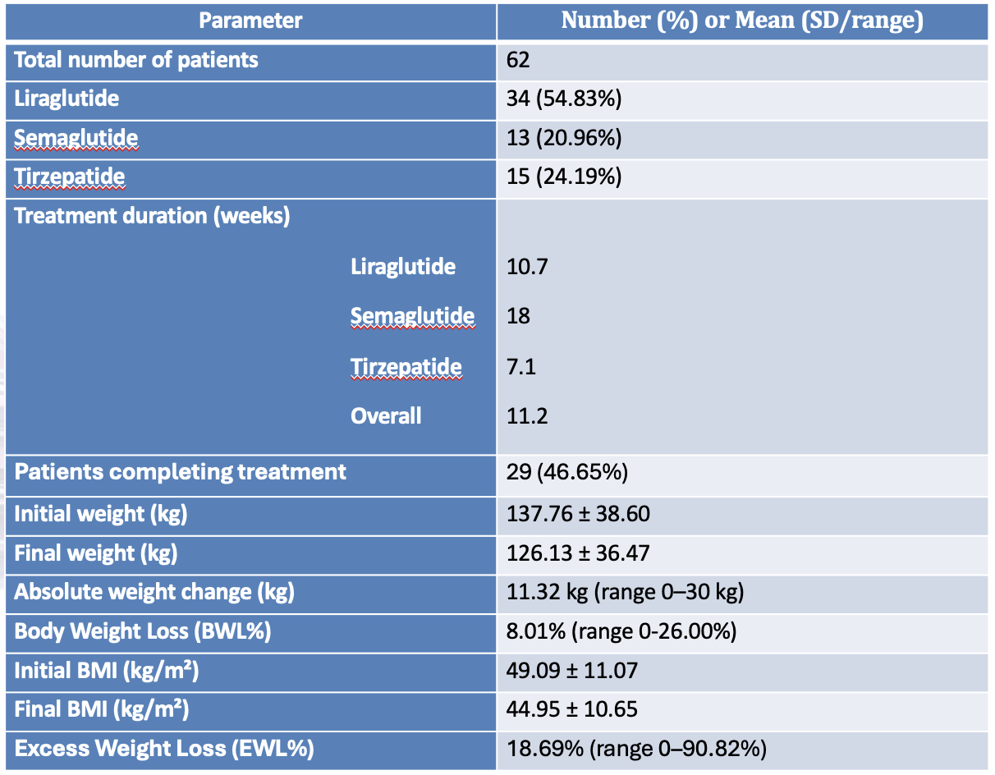
Results
62 patients
BMI 35–67.9 kg/m²
18–65 years

Slide 7
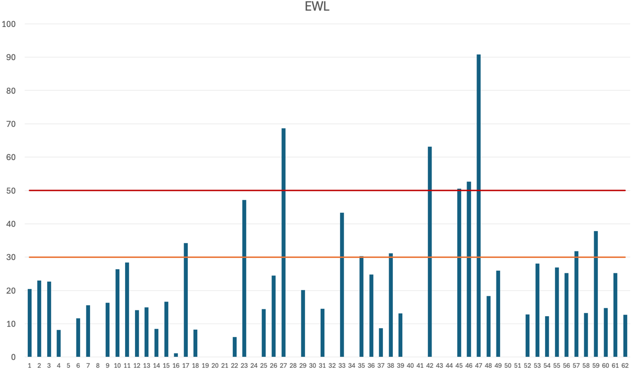
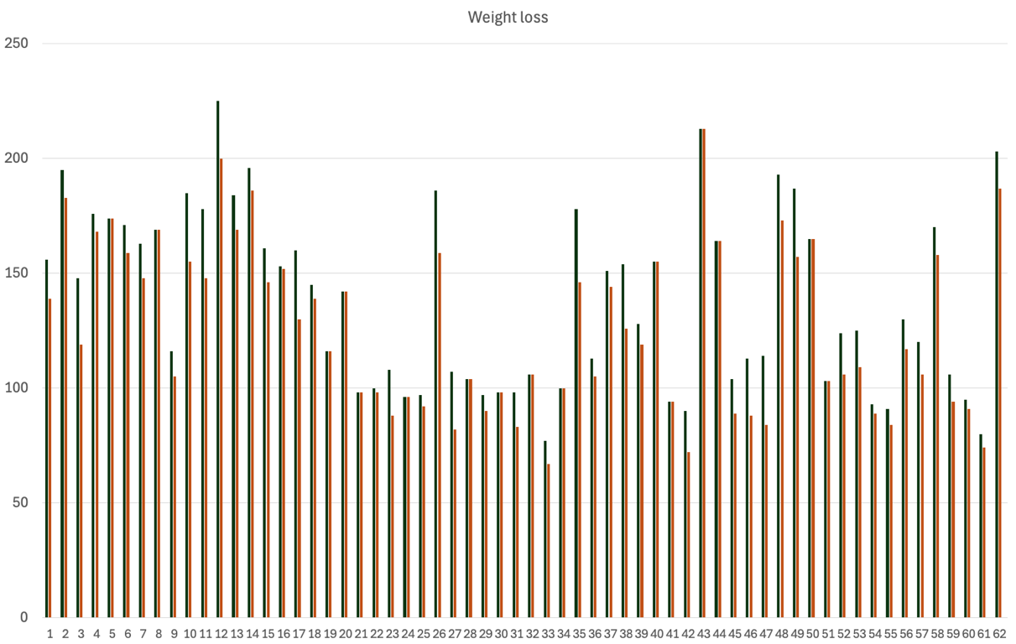
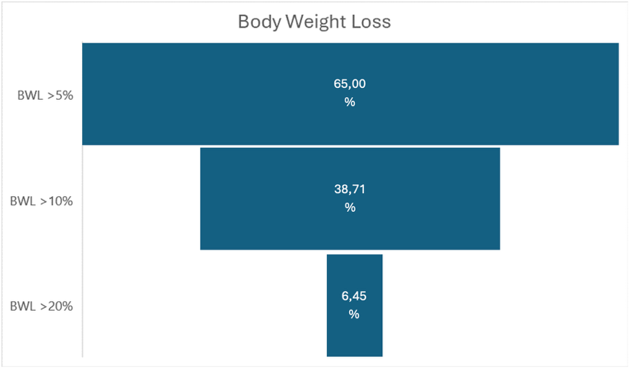
EWL > 30% 12/62 (19.35%)
EWL > 50% 5/62 (8.06%)

Slide 8
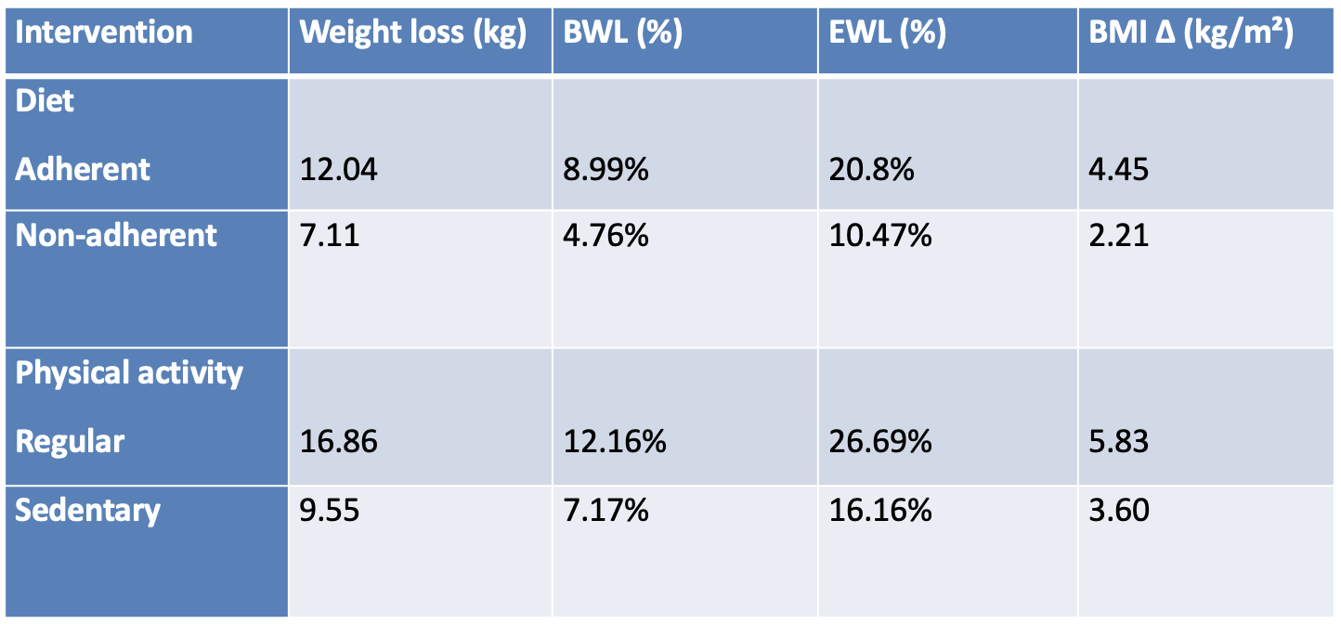
Behavioral Factors
Behavioral adherence significantly amplified pharmacologic effects

Slide 9
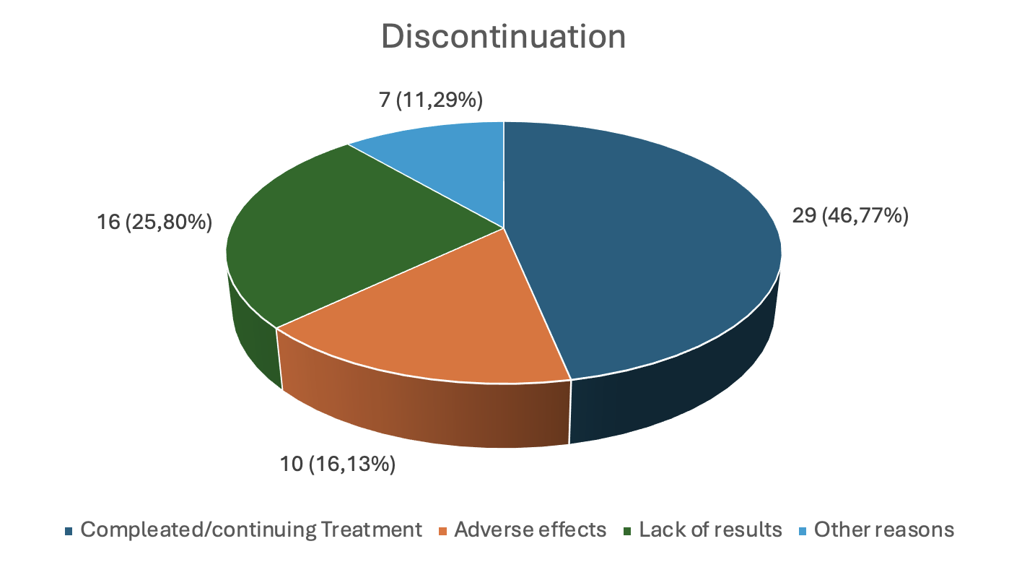
Side Effects and Discontinuation
22/62 patients (35,48%) reported adverse effects:
• Nausea/vomiting 9 (14,5%)
• Fatigue 6 (9,6%)
• Diarrhea/costipation 4 (6,45%)
• Headache 4 (6,45%)
• Tachycardia 4 (6,45%)
• Dyspepsia 2 (3,2%)
• Hypotension 1 (1,61%)

Slide 10
Impact on Surgery Decision
• 72,6% (45 patients) decided to undergo surgery:
32 suspended therapy
9 reached significative weight loss
4 still in therapy
• 27.4% (17 patients) delayed or avoided surgery:
8 achieved metabolic or weight target
8 chose to continue medical therapy
1 withdrew

Slide 11
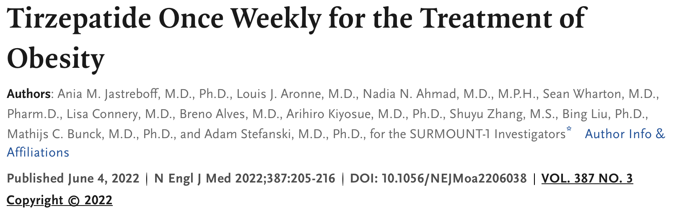
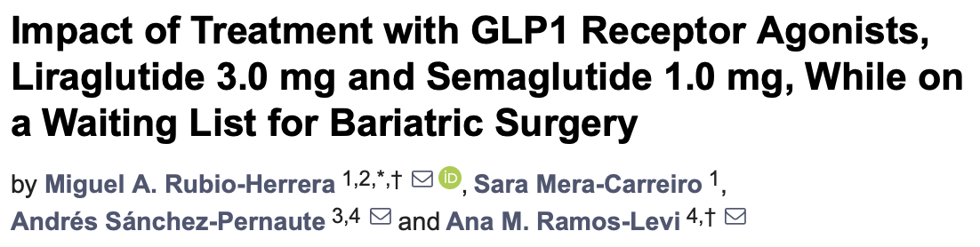
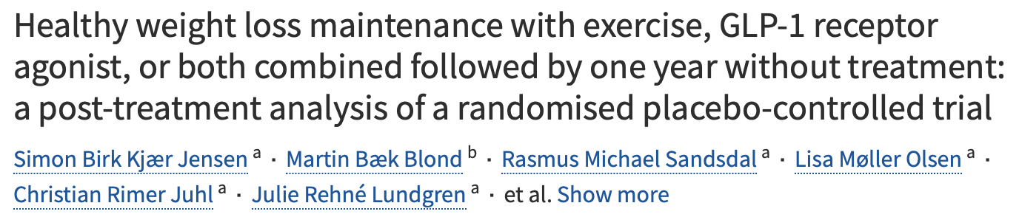
Discussion
GLP-1 RAs effectively reduce preoperative weight and BMI
limpacts patients' decisions regarding acceptance or rejection of the procedure
Adherence and multidisciplinary approach are essential
Adverse effects of mild intensity and well tollerated
- Pi-Sunyer X, Astrup A, Fujioka K, Greenway F, Halpern A, Krempf M, Lau DC, le Roux CW, Violante Ortiz R, Jensen CB, Wilding JP; SCALE Obesity and Prediabetes NN8022-1839 Study Group. A Randomized, Controlled Trial of 3.0 mg of Liraglutide in Weight Management. N Engl J Med. 2015 Jul 2;373(1):11-22. doi: 10.1056/NEJMoa1411892. PMID: 26132939.
- Wilding JPH, Batterham RL, Calanna S, Davies M, Van Gaal LF, Lingvay I, McGowan BM, Rosenstock J, Tran MTD, Wadden TA, Wharton S, Yokote K, Zeuthen N, Kushner RF; STEP 1 Study Group. Once-Weekly Semaglutide in Adults with Overweight or Obesity. N Engl J Med. 2021 Mar 18;384(11):989-1002. doi: 10.1056/NEJMoa2032183. Epub 2021 Feb 10. PMID: 33567185.

Slide 12
Limitations
Retrospective design
Small sample size
Short duration
No long-term follow-up

Slide 13
Conclusions
GLP-1 receptor agonists are safe and effective as bridge-to-surgery therapy and a valid therapeutic alternative.
However, important issues such as limited accessibility, treatment adherence and long-term maintenance of weight loss still need to be addressed.
Bariatric surgery continues to represent the mainstay treatment for severe obesity.

Slide 14

Università degli studi di Foggia
Clinica Chirurgica:
Direttore Prof. Antonio Ambrosi
Scuola di Specializzazione in Chirurgia Generale:
Direttore Prof. Nicola Tartaglia

